Slide 1
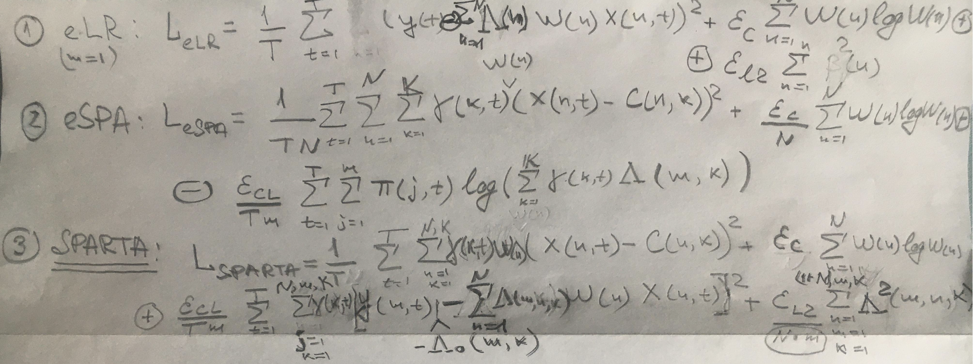
From eSPA to entropically-sparsified Linear Regression (eLR)
and to Sparse Probabilistic Approximation for Regression Task Analysis (SPARTA)
Mathematical idea behind SPARTA: joint numerically-scalable (linear in T and K, loglinear in N) solution of feature X discretization (first term), entropic feature sparsification (second term) and regularized piecewise-linear regression problems (third and fourth terms)

Slide 2
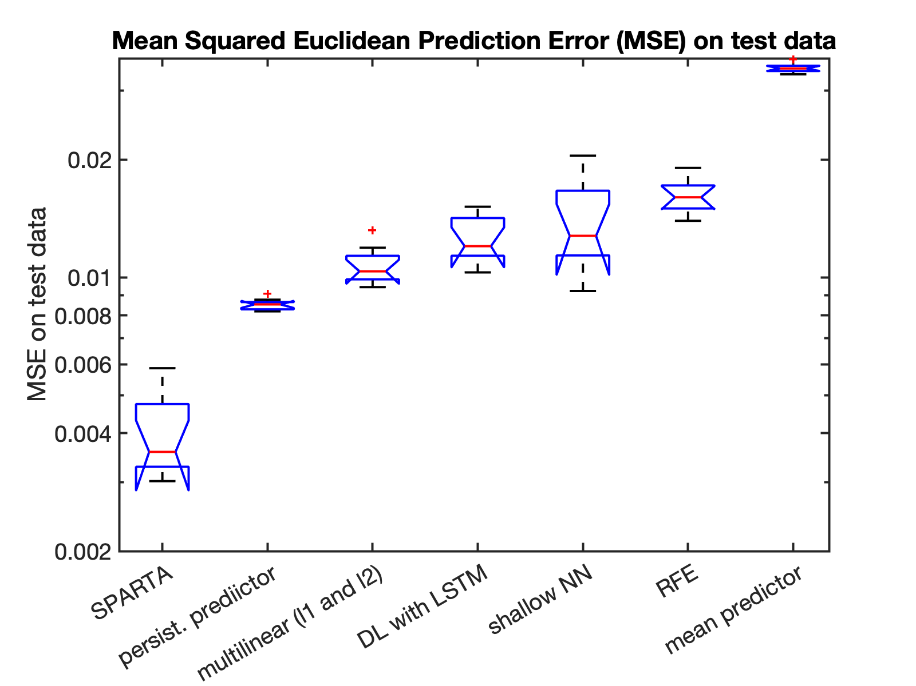
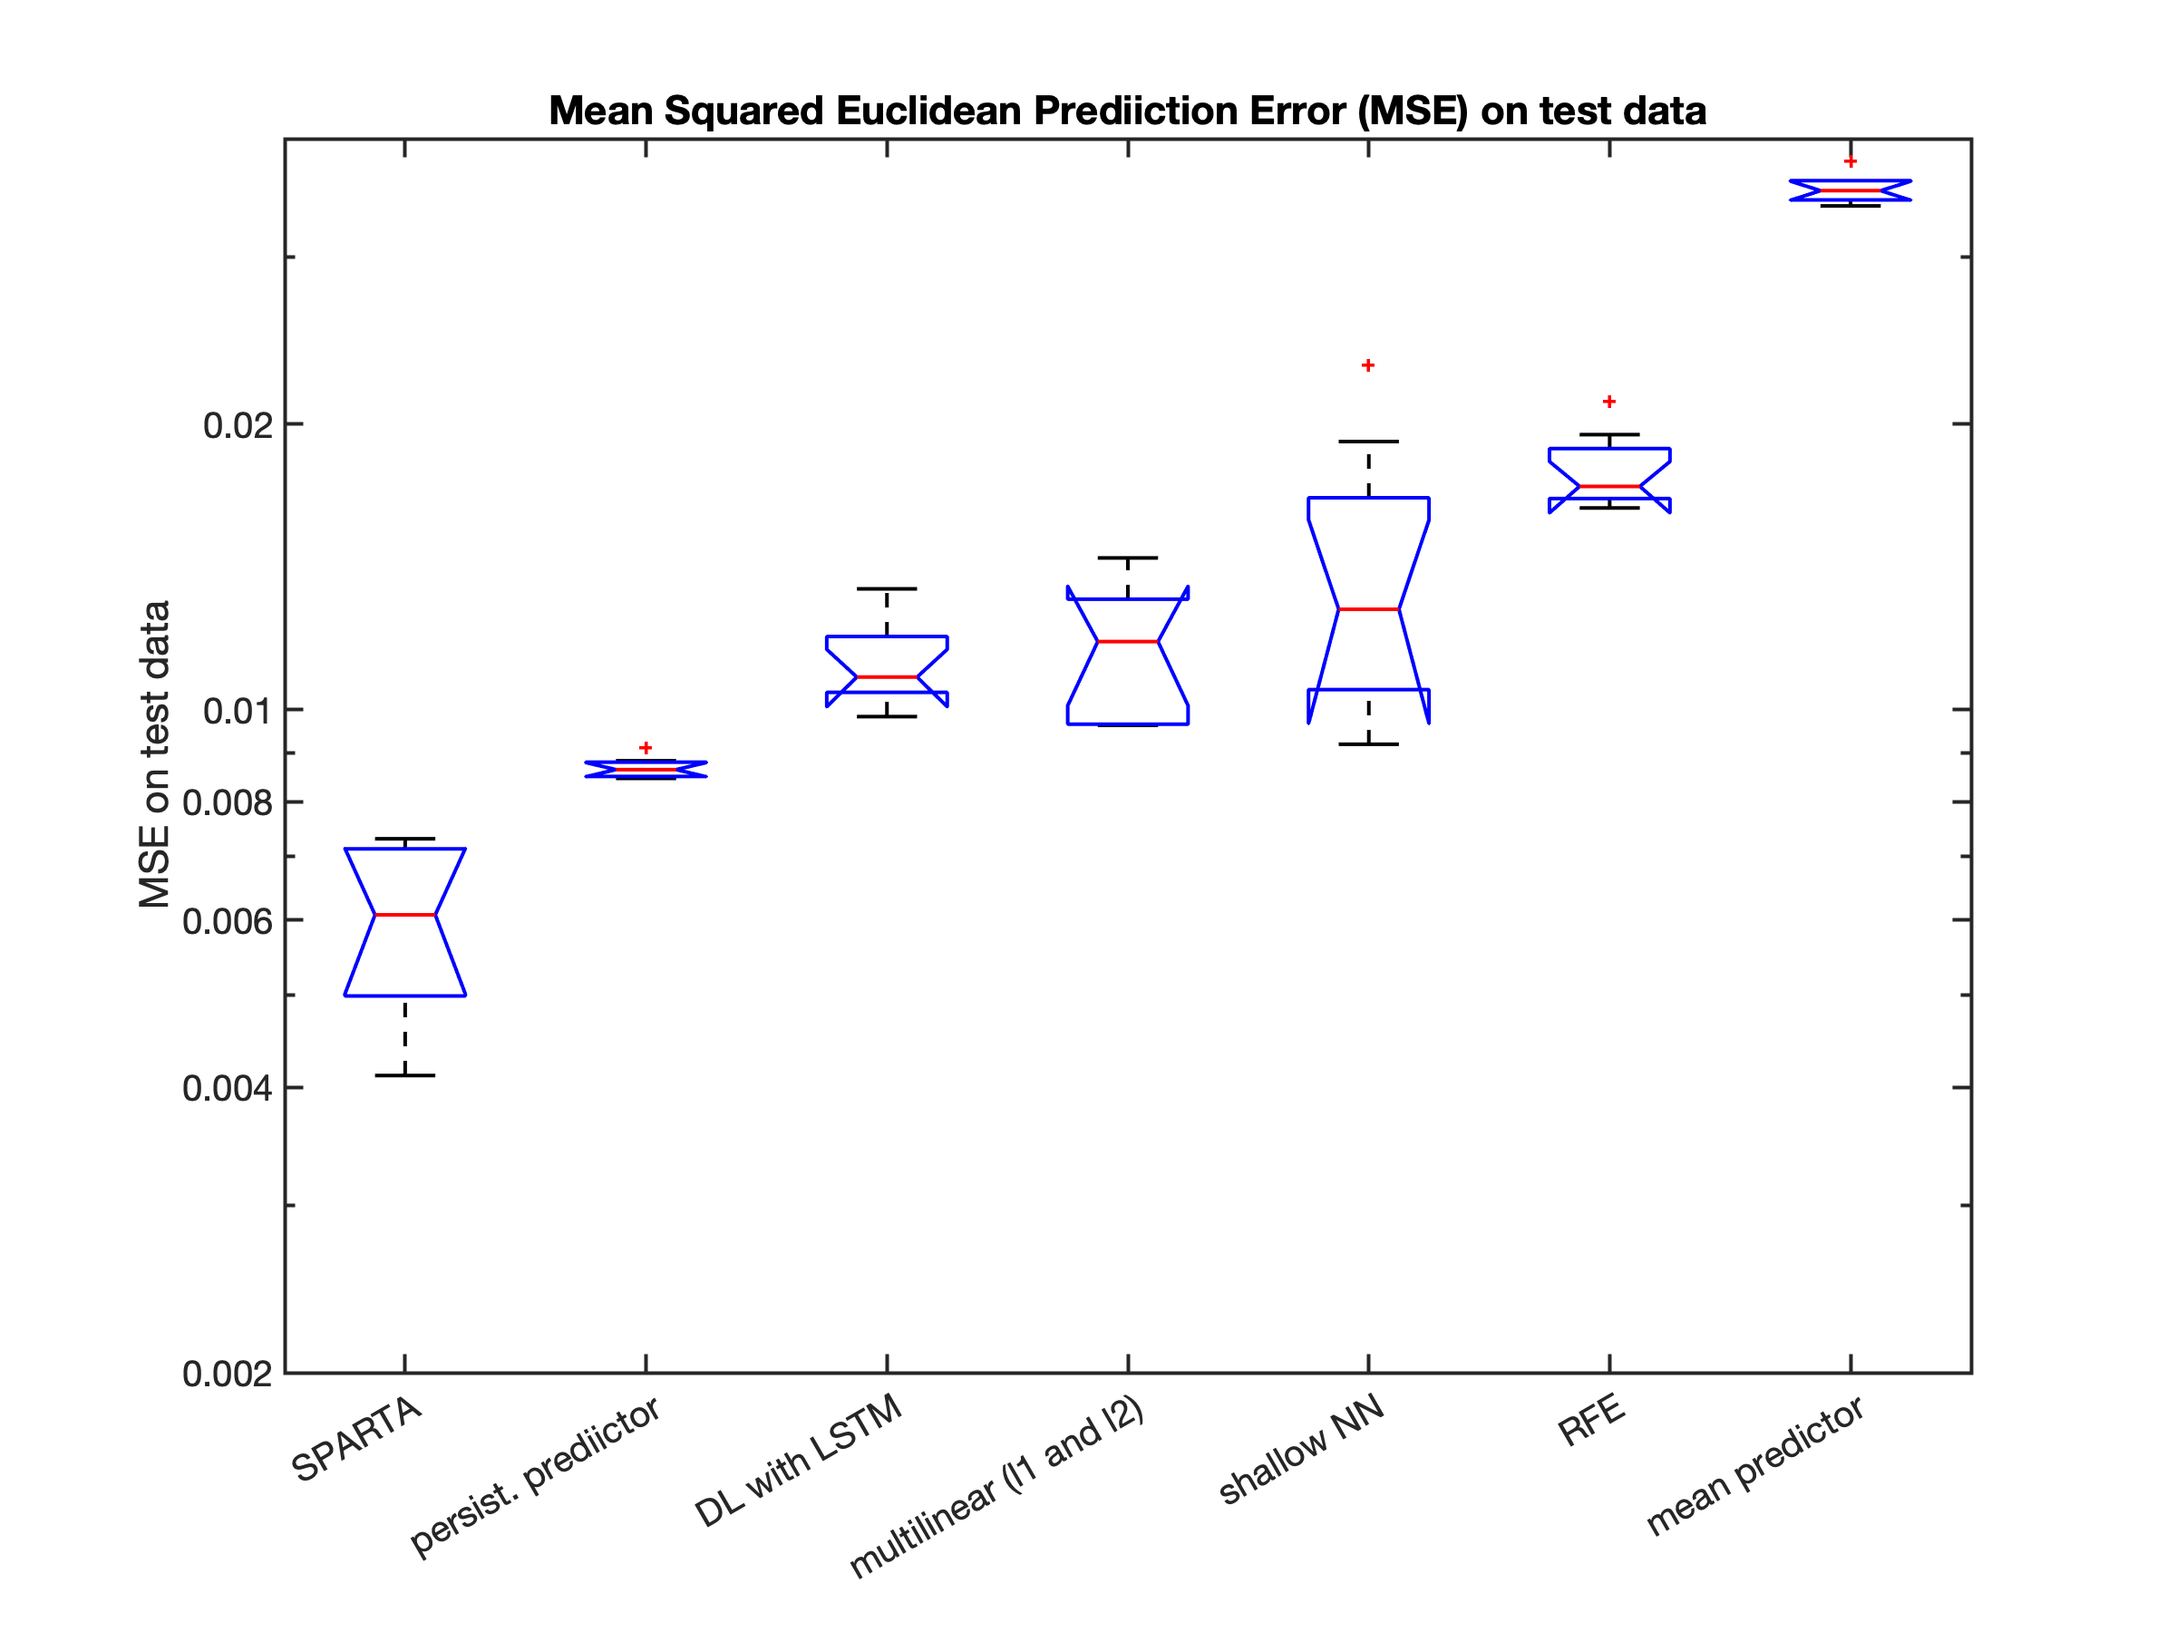
Comparing ML and AI methods for predicting ENSO value with two months lead time
Predictions with Vertical Water Temperatures
in equatorial Pacific
Predictions without Vertical Water Temperatures
in equatorial Pacific
SPARTA – Sparse Probabilistic Approximation for Regression Task Analysis (new method)
persiist. predictor – prediction with a model ENSO(t+2 months)=ENSO(t)
RFE – Random Forest Ensemble with Regression Trees
multilinear (L1 and L2 regularized) – regularized linear regression
DL with LSTM – Deep Learning with Long Short-Term Memory
shallow NN – feed-forward NN
mean predictor - prediction with a model ENSO(t+2 months)=mean(ENSO)

Slide 3
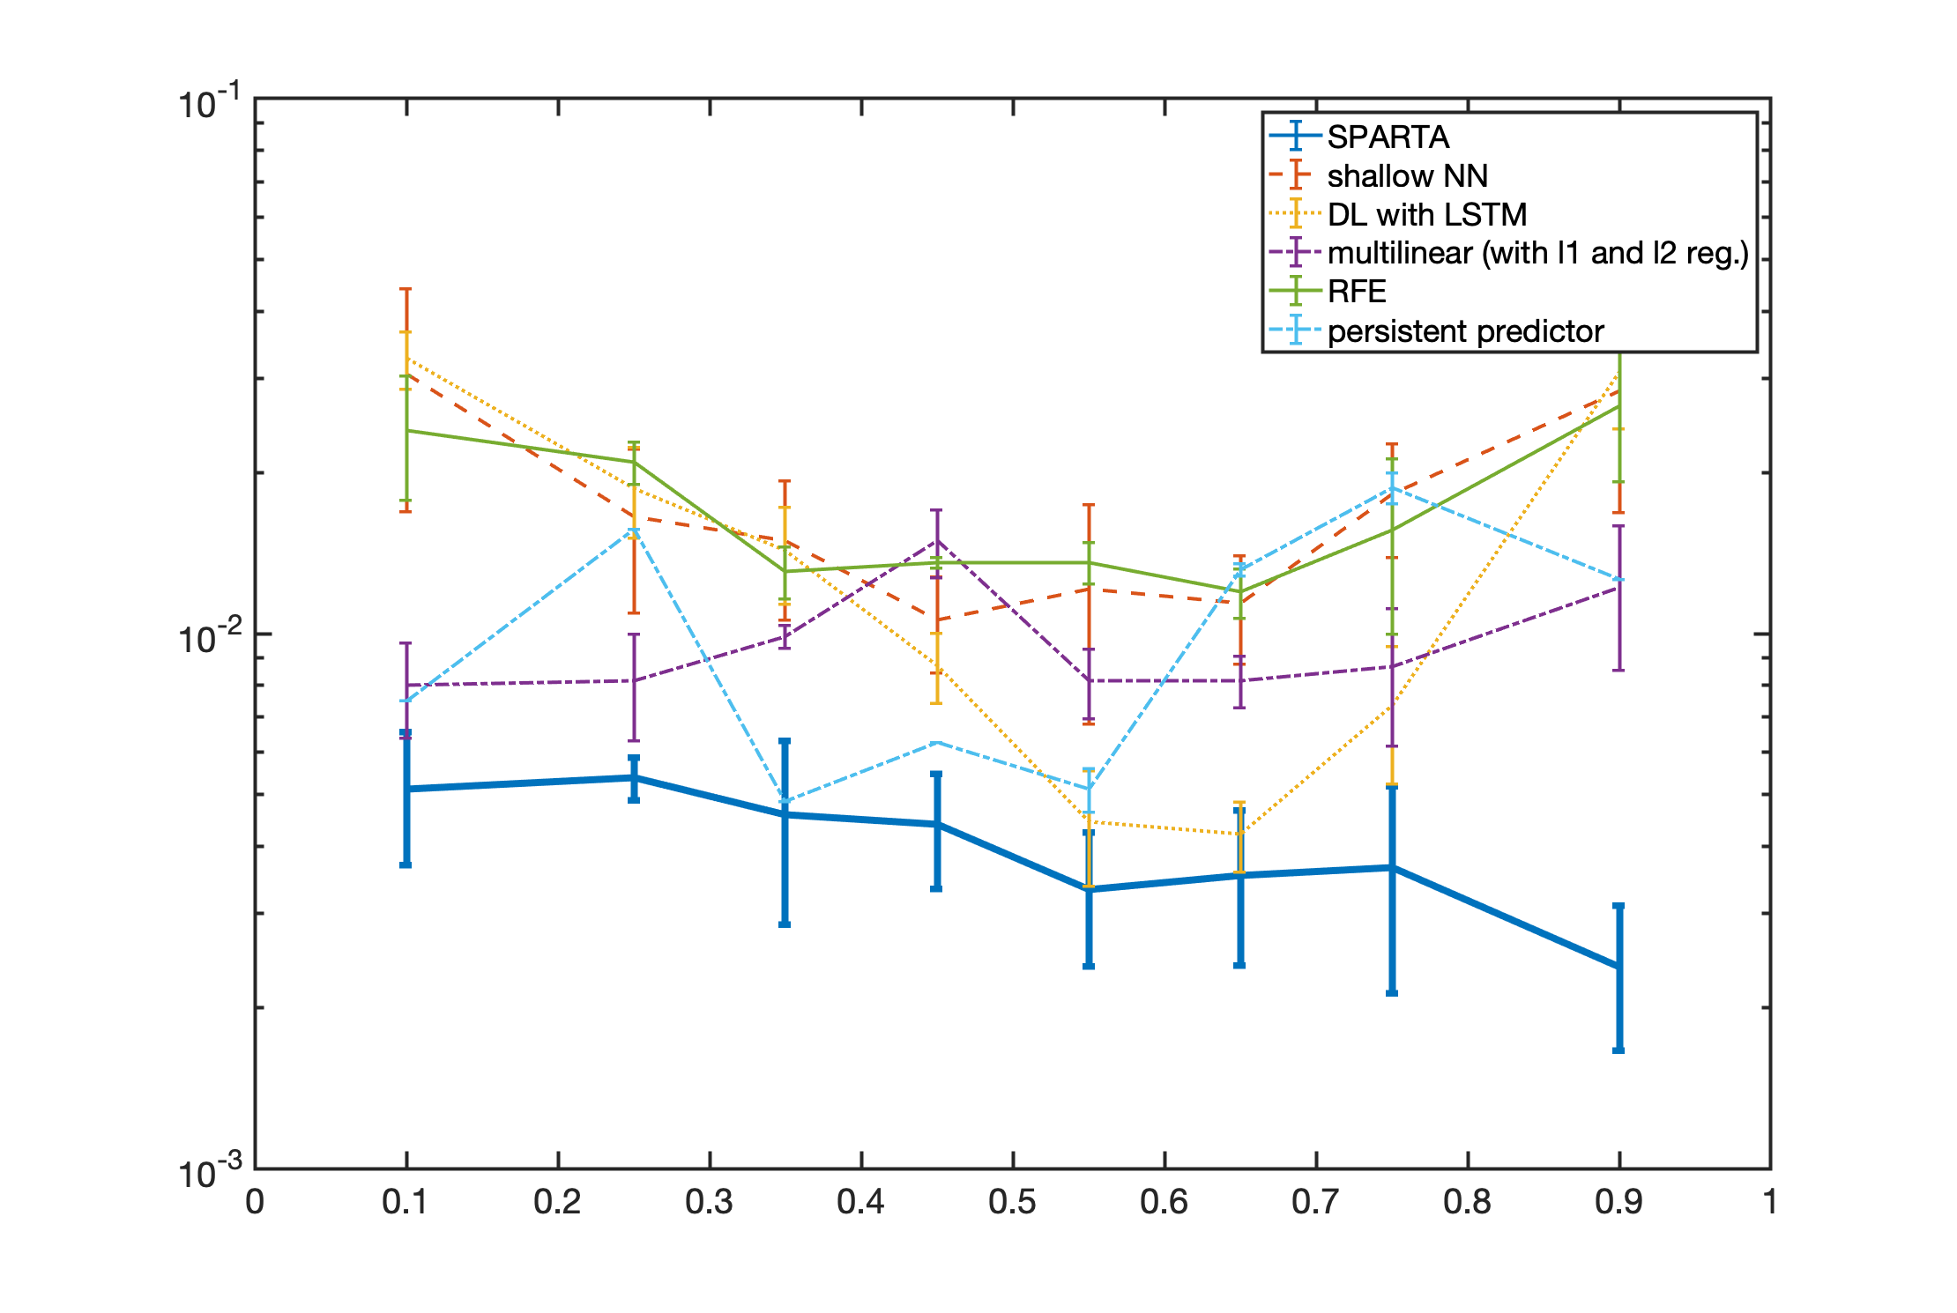
Comparing ML and AI methods for predicting ENSO value with two months lead time
MSE on test data
ENSO
minimum
ENSO
maximum
SPARTA – Sparse Probabilistic Approximation for Regression Task Analysis (new method)
persiist. predictor – prediction with a model ENSO(t+2 months)=ENSO(t)
RFE – Random Forest Ensemble with Regression Trees
multilinear (L1 and L2 regularized) – regularized linear regression
DL with LSTM – Deep Learning with Long Short-Term Memory
shallow NN – feed-forward NN
mean predictor - prediction with a model ENSO(t+2 months)=mean(ENSO)

Slide 4
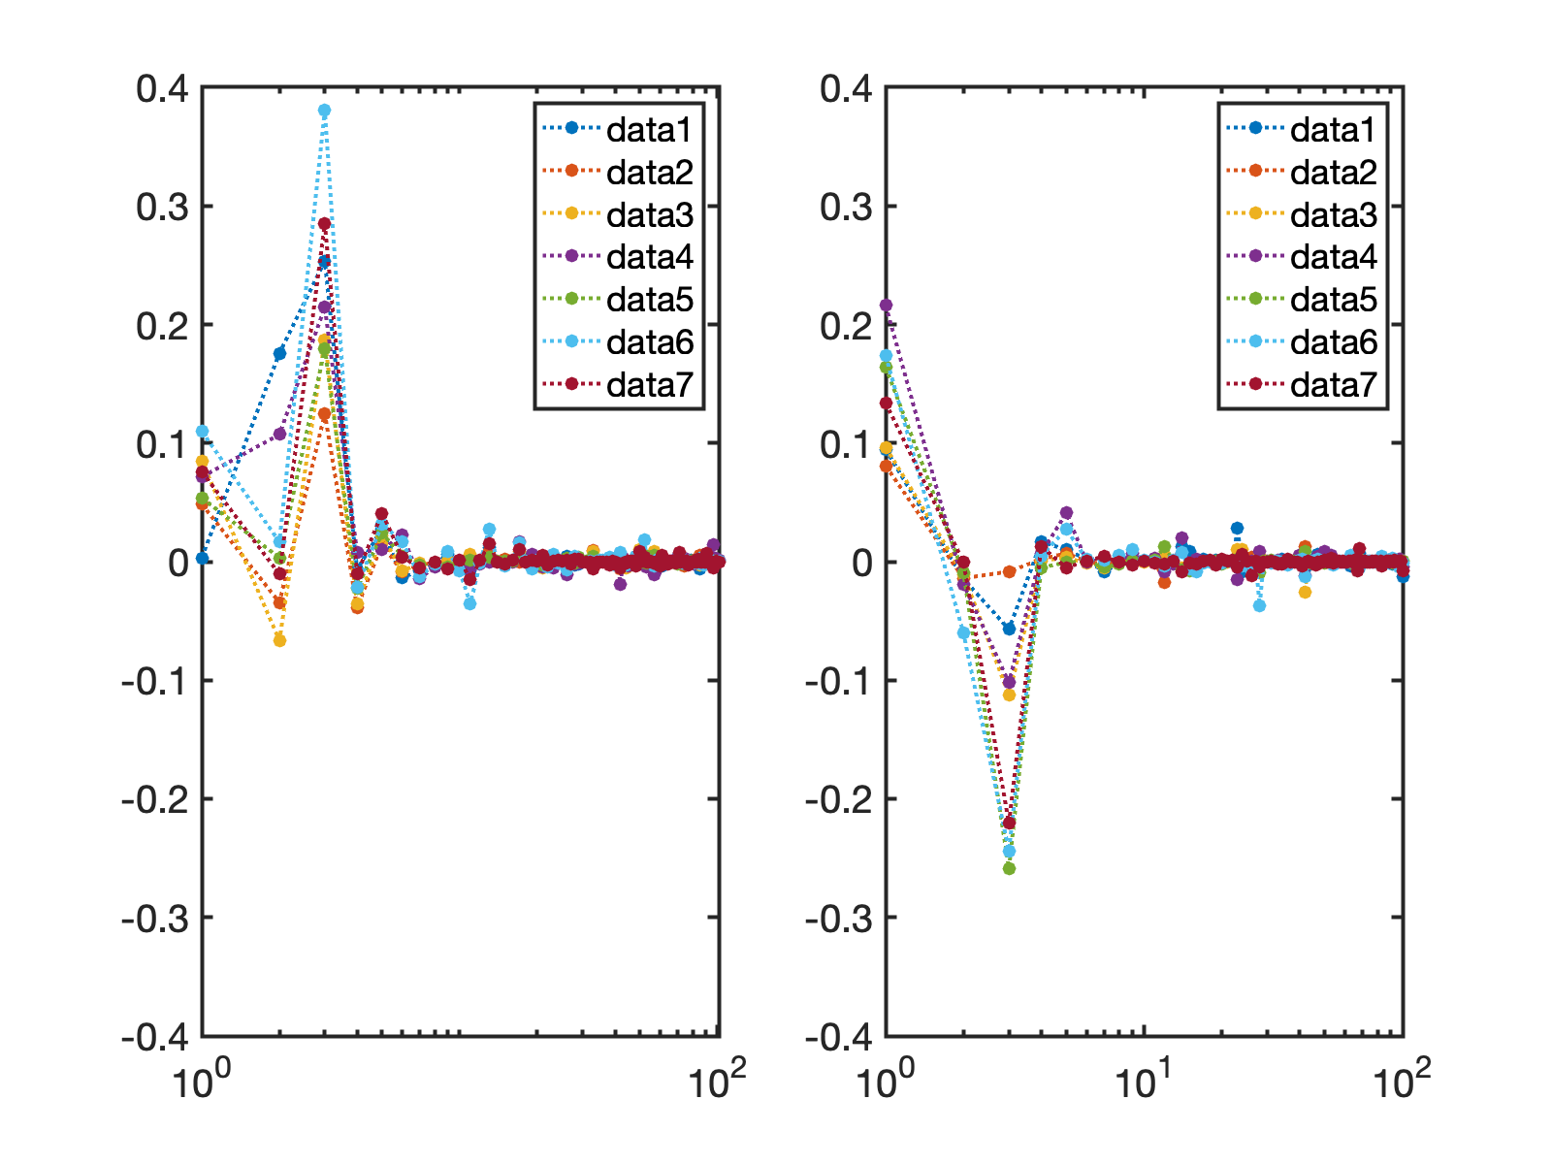
Comparing ML and AI methods for predicting ENSO value with two months lead time
Regression coefficients W(n)𝛬(n,k) for k=1:7
for SST EOF modes
Regression coefficients W(n)𝛬(n,k) for k=1:7
for equatorial 𝛥Z EOF modes

Slide 5
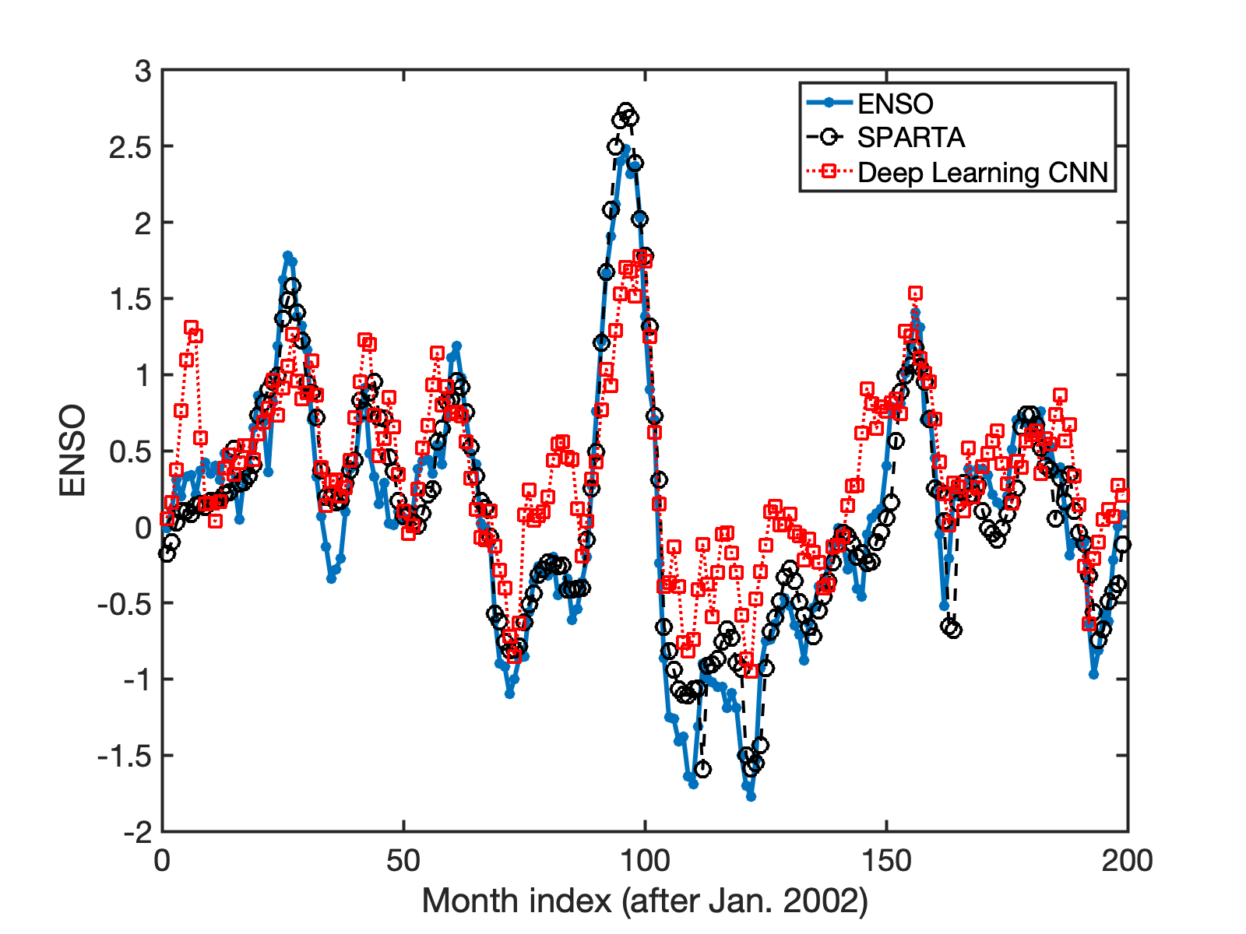
Comparing ML and AI methods for predicting ENSO value with two months lead time
models training – monthly data between 1953 and 2002
models performance comparison (figure above) - – monthly data between 2002 and 2019

